Slide 1
Unix & Storage

Slide 2
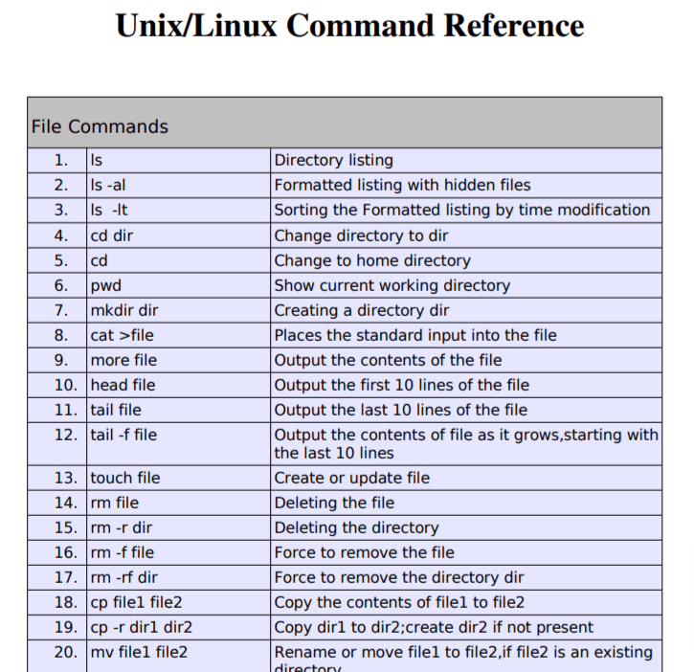
Basic Commands

Slide 3
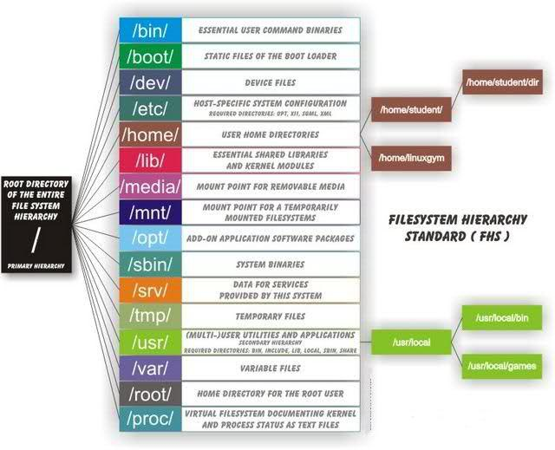
Directory hierarchy

Slide 4
Basic commands
ls
cat
cd
pwd
cp
mv
touch
vi editor
mkdir
rm
ln
grep
less
more
head
tail
sort
cut
sed

Slide 5
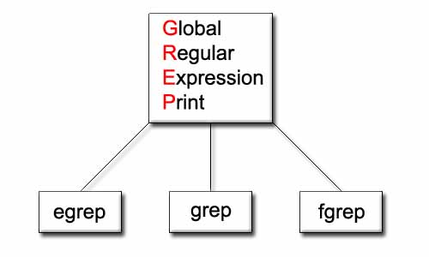
Basic commands
Using > or >> filename after the command, and Using tee comm
grep,egrep
find
https://www.tecmint.com/35-practical-examples-of-linux-find-command/

Slide 6
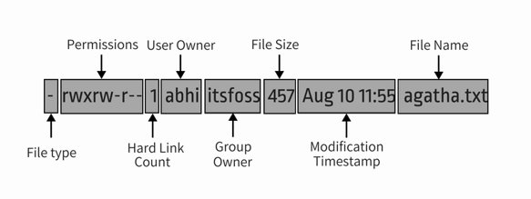
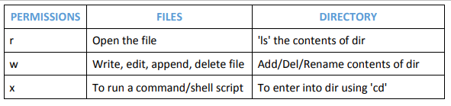
Permissions & Ownerships
umask
Usage of chmod and chown
r=4
w=2
x=1
Rwx=7

Slide 7
User administration
Useradd or adduser
Groupadd
User/groups config/administration
Centrify administration
KB0128001

Slide 8
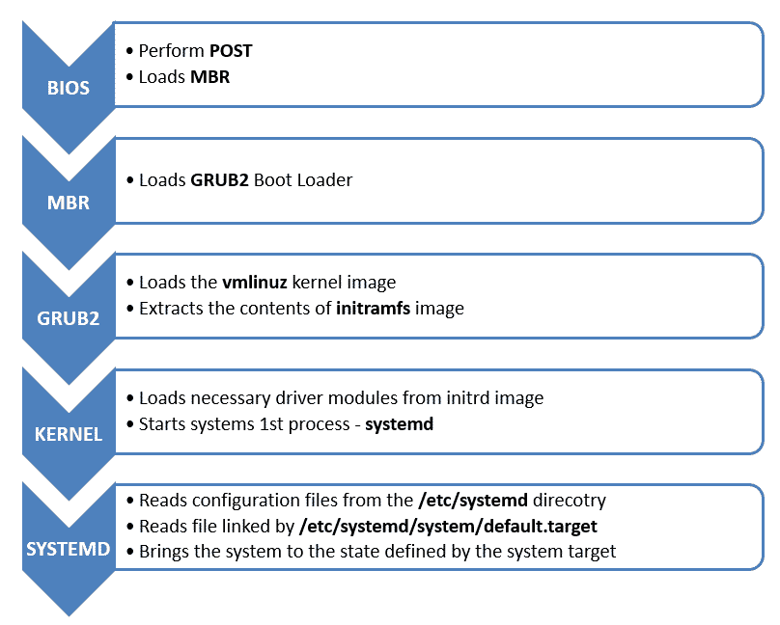
Boot process

Slide 9
Boot Troubleshoots
Root password change
Dracut errors
Filesystem corrupt errors
Control+D error
Nfs share hung

Slide 10
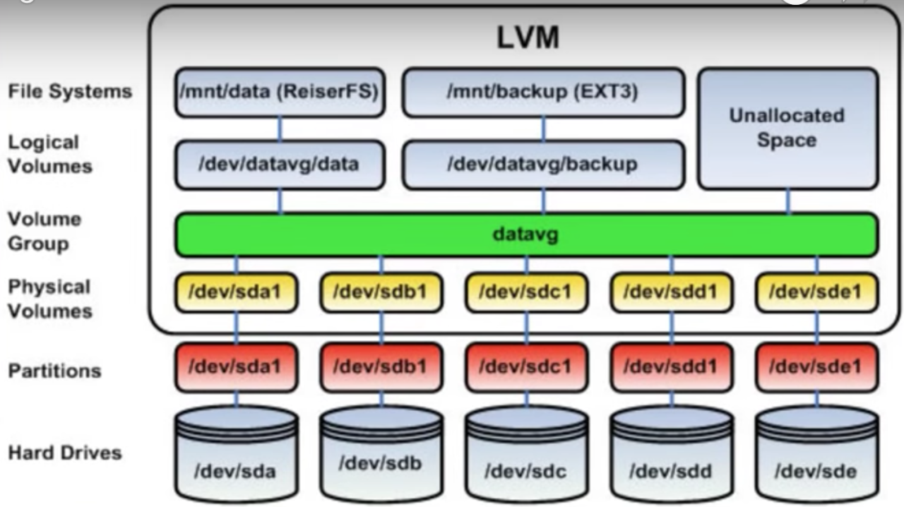
File system management
Fdisk usage for the disk configuration
Swap filesystem creation
Filesystem creation and mount
LVM
Disk config via LVM

Slide 11
RedHat Package Management
Install and uninstall software by Rpm
Install and uninstall software by Yum
Yum configuration and its management
https://access.redhat.com/articles/rhsm-cheat-sheet

Slide 12
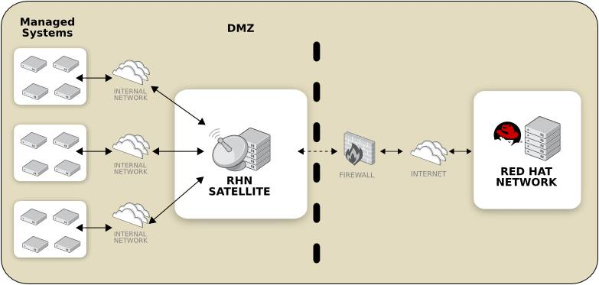
RedHat Satellite setup

Slide 13
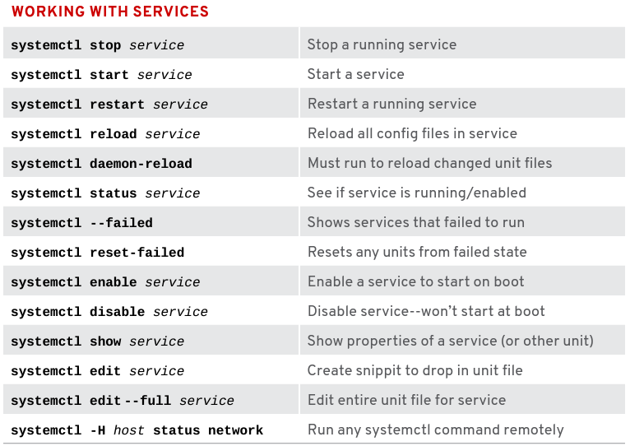
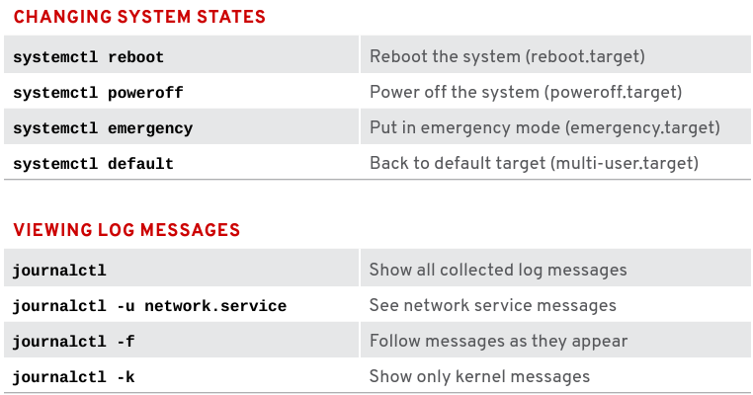
Service Management
systemctl

Slide 14
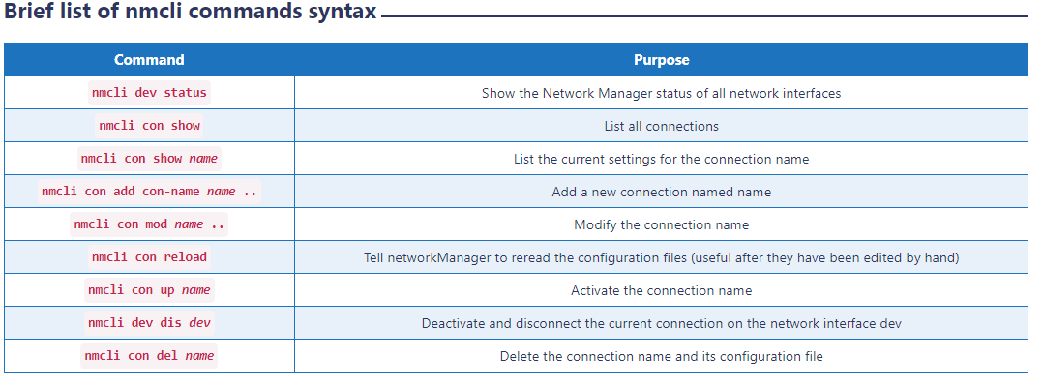
Network Management
Network configuration with nmcli

Slide 15
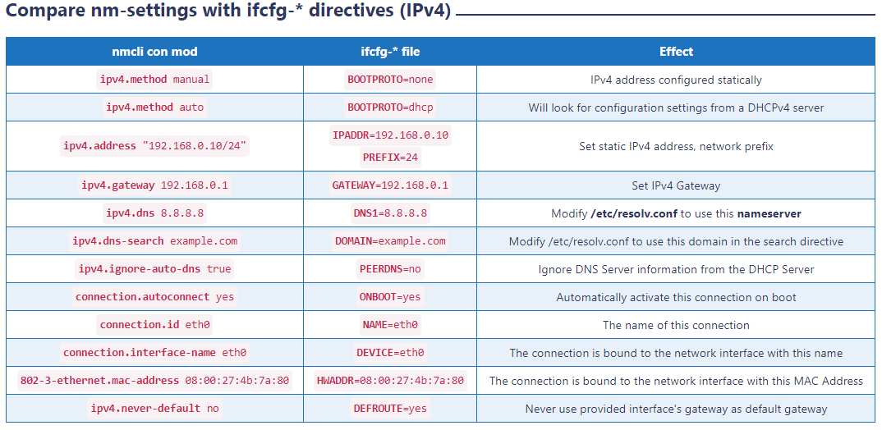
https://www.golinuxcloud.com/nmcli-command-examples-cheatsheet-centos-rhel/

